Slide 1



III-Special epithelium: -
محاضرة هستولوجي لطلاب دبلومة الكيمياء الحيويه
2019-2020
Dr\ Ehab Elzoghby

Slide 2
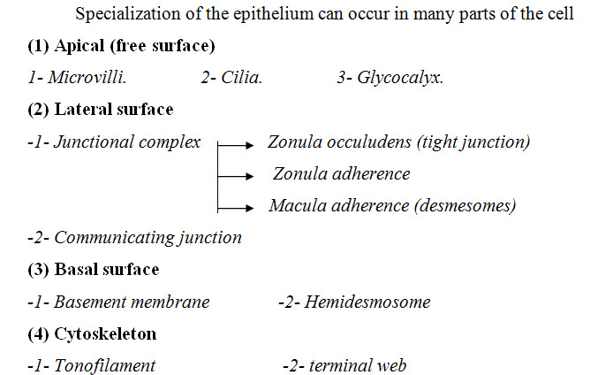

Slide 3
(1) Apical (free surface):-
1-Microvilli

Slide 4
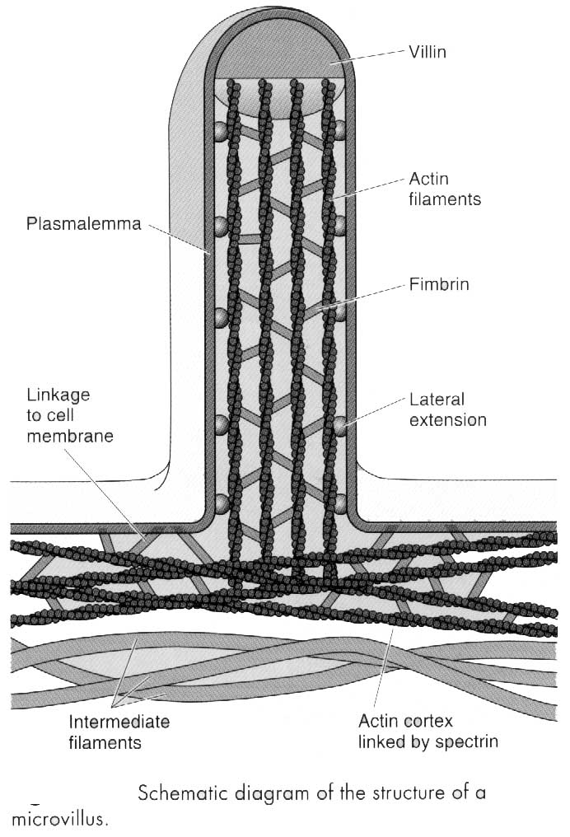

Slide 5
Delicate finger like or hair like projection from the upper surface of the cell
It originate from multiple evagination of the plasma membrane & underlying cytoplasm
Microvilli contain core of fine 6.nm filamentous riming in their longitudinal axes & perpendicular to the cell surface. They are Actin filament
The Actin bundle attached to the plasma membrane at apical tip of the villi (dense tip)
The basal part of the filament embedded in & inter connected with other filament (terminal web)
It increase in the apical surface, they contain either secretory or absorptive process as recorded in the intestine.

Slide 6
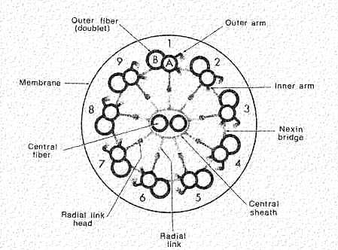
2-Cilia
As described before in Cytology

Slide 7
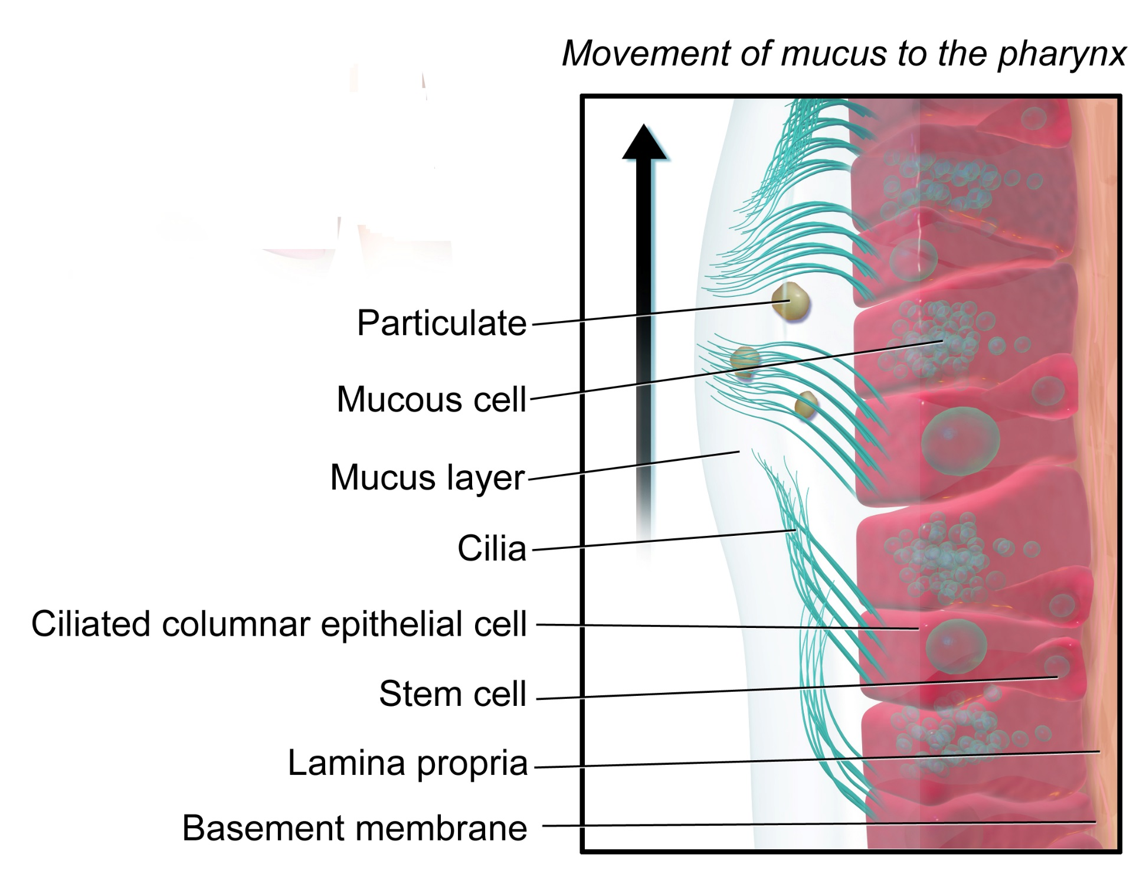

Slide 8
3-Glycocalyx
The glycocalyx consists of carbohydrate and protein embedded in plasma membrane. This structure contains hydrolytic enzymes eg. In the surface of the absorptive cell of small intestine

Slide 9
