Slide 1
SPECIES:
Sterptococcus pyogenes
Sterptococcus agalactiae
Sterptococcus dysagalactiae
Sterptococcus uberis
Sterptococcus equi
Sterptococcus zooepidemicus
Sterptococcus canis
Sterptococcus gallinerum
Order: EUBACTERIALIS
Family: LACTOBACTERIACE
Genus: STERPTOCOCCUS

Slide 2
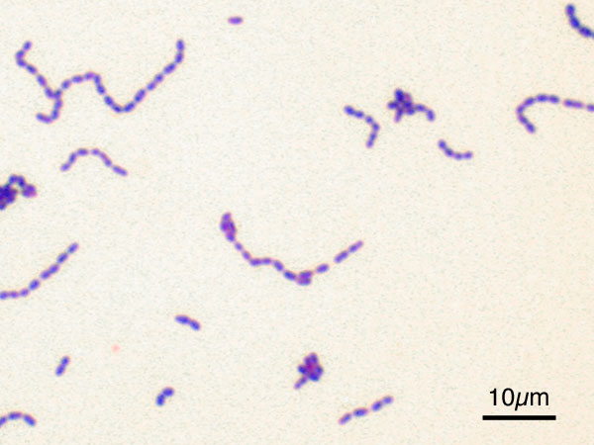
Morphological characters:
It is spherical or ovoid cocci in shape 0.5 µ in diameter, it is usually arranged in chains of various length, gram positive .they are non motile, non sporulated but some strains are capsulated (slime layer).
General characters of Streptococci:

Slide 3
Streptococci are aerobic or facultative anaerobic, grow weak on ordinary media but grow well on blood or serum agar at 37ºc and ph 7,2 . The organism produces haemolysis on blood agar plate the specific media areEdward´s blood ager media and sodium azide agar media.
Streptococcus doesn’t produce pigments either in fluid media or on solid media. The colonies on blood agar are small, smooth –glistening after 48 hours, while in broth granular growth and powdery sediment are formed within 36-48 hours.
Growth requirements and cultural characters:

Slide 4
1-according to type of haemolysis :
Streptococci causing complete haemolysis (Beta (β) haemolysis), a clear zone of haemolysis as Strept.pyogenes and Strept.equi.
Streptococci causing in complete haemolysis (alpha α) such as Strept.viridians and pneumococci.
C) Streptococci causing no haemolysis (gamma γ), non hemolytic streptococci as Strept.lactis and Sterpt.salivaris.
Classification:

Slide 5
2-Lancifield classification:
Lancefield reported that the hemolytic streptococci could be divided into groups (A-N) on serological basis depending on precipitation test using the specific carbohydrate substance designated as C.substance as the antigen which differed in each group:
- Group A: Streptococcus pyogenes
- Group B: Streptococcus agalactia
-Group C: animal streptococci as streptococcus zooepidemicus, Streptococcus dysgalactia, Streptococcus equi, Streptococcus canis.
-Group D: Enterococci as streptococcus fecalis ,Streptococcus faecium
-Group E: Strains isolated from milk and dairy products as Streptococcus uberis
-Group F: Strains isolated from respiratory tract.
-Group G: Strain isolated from respiratory tract of man and dogs.
-Group H, K, M and group N

Slide 6
3-Sharman classification:
It depends on the biochemical characters of the enterococci or non pathogenic streptococci on the following reactions:
Growth at 10 ºc and 45ºc as Strept.viridians.
Tolerance to 6.5 % sodium chloride.
Reduction of methylene blue.

Slide 7
Morophological characters:
Strept.pyogenes are arranged in long chain, it is cocci , non motile , non sporulated, has capsule in young culture and gram positive.
Distribution:
It is widely distributed on the skin and in the mucous membrane
Streptococcus pyogenes

Slide 8
Growth requirements and cultural characters:
Strept.pyogenes grow on media containing blood or serum at 37ºc and PH 7.2 .
Its colonies on the solid media are very small, smooth glistening, dew drop like, finally granular and not pigmented.
The colonies produce zone of complete haemolysis (beta haemolysis)on blood agar after (24-48) incubation

Slide 9
Biochemical properties:
The organism ferments glucose, lactose,sucrose, and salicin producing acid only do not ferment sorbitol, do not liquefy gelatin, catalase negative and indol negative.
Resistance:
Strept. pyogenes killed by 60ºc for half hour , so laboratory cultures should be stored at (3-5ºc) in blood broth .
The organism is sensitive to sulfonamides and penicillin.

Slide 10
It produces two soluble haemolysins which cause haemolysis of erythrocytes.
Strept. pyogenes produces a leucocyte destroying substance known as leucocidine.
Itproduces erythrogenic toxin which is responsible for the characteristic skin lesions of scarlet fever.
Produce fibrinolysin ,proteinase, hyalouronidase (spreading factor ).
toxins and enzymes:

Slide 11
Somatic (o)antigen
Capsular antigen
(m) protein only in s.pyogen
Pathogenicity:
Strept. pyogenes causes a number of disease in man.
It is associated with scarlet fever, septic sore throat, tonsillitis and various suppurative inflammatory conditions.
The organism invades the bovine mammary gland producing mastitis.
Some strains of Strept. pyogenesare highly virulent for the mouse and rabbit, guinea pig is more resistant.
Antigenic structure

Slide 12
By direct smears of the exudates from the lesions of the disease usually reveal long chains of streptococci.
Haemolysis of blood media.
Lancifield technique with various biochemical tests.
Laboratory diagnosis of Strept.pyogenes infections:

Slide 13
Differences between Staph.aureus and Strept. pyogenes:
Strept. Pyogenes | Staph. Aureus | Characters
Long chains | Grape like clusters | Arrangement
After 48 hours | After 24 hours | Growth
Clear and granular sediment | Turbid and thick sediment | Turbidity in broth
Minute, transparent, non pigmented | Round, convex, opaque and pigmented | Colonies on ordinary media
– | + | Catalase test
– | + | Gelatin liquefaction
– | + | Methylene blue
Sensitive | resist | Bactiracin

Slide 14
MASTITIS STREPTOCOCCI:
These three species of streptococcus are biochemically and serologically different; however, they are associated with bovine mastitis.
Streptococcus agalactiae•
Streptococcus dysgalactiae•
Streptococcus uberis•

Slide 15
Gram positive cocci
Arranged in long chain( s. agalactica, s. disagalactiva) short chain (s. ubris)
Non motile, non sporulated, non capsulated)
Morphology and staining:

Slide 16
Growth requirement and cultural characters:
These organisms grow well on blood or serum agar, also the use of sodium azid crystal violet blood agar facilitates the isolation of these organisms.
It is aerobic and microaerophilic and grow at 37 ºc.
Strept. agalactiae and strept. dysgalactia usually produces flocculent growth in the bottom of the tube with clear supernatant liquid above while Strept. ubris produce a uniform turbidity in both medium.
Strept. agalactia produces beta haemolysis on agar if it is refrigerated after 24 hours incubation at 37ºc while Strept. dysgalactiaand Strept. uberisare non haemolytic

Slide 17
Biochemical reaction:
Indol negative, doesn’t liquefy gelatin and doesn’t reduce nitrate.
Strept. agalactiae and Strept. dysgalactia do not ferment sorbitol while Strept. ubris ferment sorbitol.
Strept. agalactiae ferment salicin while Strept. dysgalactia do not ferment salicin.
Esculin hydrolysis in Strept. ubris is positive

Slide 18
Resistance and viability:
As Streptococcus pyogenes.
Somatic antigen only
Haemolycin , leucocidin
Three organismscausepranchymatousmastitis in cow, sheep and goats
Antigenic structure and toxin:
Toxins
Pathogenicty :

Slide 19
Isolation and identification of streptococci from milk samples.
By Hottis and miller test for the detection of Strept. Agalactiae, this test is performed by adding 0.5 ml of sterile 0.5 % aqueous solution bromocresol purple to 9.5 ml milk. The milk is incubated 24 hours at 37ºc and the test is read where the appearance of canary-yellow colonies of bacterial growth along the walls and in the bottom of the test tube is diagnostic of Strept. agalactiae infection .
Laboratory Diagnosis:

Slide 20
Differentiation between the 3species of streptoccoci caising mastitis:
St.ubris | St.dysgalactiae | St.agalactiae | Test
E | C | B | 1)lancifield group
γ | γ(α) |  | 2)haemolysis on blood
 |  | Well | 3) Growth on bile salt.
 |  | + | 4)CAMP test
+ |  | + | 5)Na hippurate test
+ |  | – | 4)Aesculin hydrolysis.
Subacute | Acute | Chronic | 7) Type of mastitis.

Slide 21
STREPTOCOCCUS EQUI
As s. pyogen
Pathogenesis
Cause strangle

Slide 22
glander | strangle
In upper respiratory tract Cause respiratory manifestation | In upper respiratory tract Cause respiratory manifestation
Less than 5 years | More than 5 years | Age of animal affected
Pseudomonus mallie | s. equi | Causitive agent

