Slide 1
BACTERIAL GENETICS

Slide 2
ALL PROPERTIES OF medical importance of BACTERIAL CEll
VIRULENCE PATHOGENICITY ANTIBIOTIC RESISTANCE
DETERMINED BY GENETIC INFORMATION IN THE CELL GENOME

Slide 3
the genetic information is normally encoded by the specific sequence of nucleotide bases
adenine A
guanine G thyamin T C cytosine

Slide 4
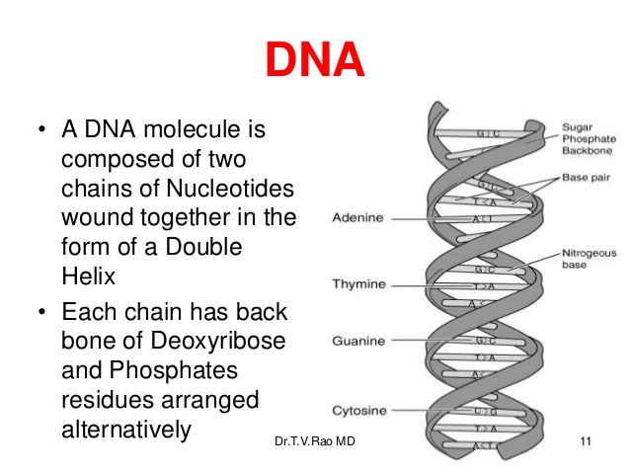
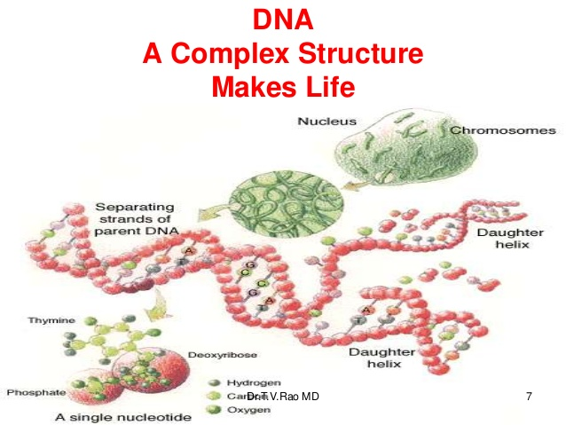

Slide 5
N.B
DNA of bacterial cell is not associated with protein or histone molecules
As it is in ………………………..????

Slide 6
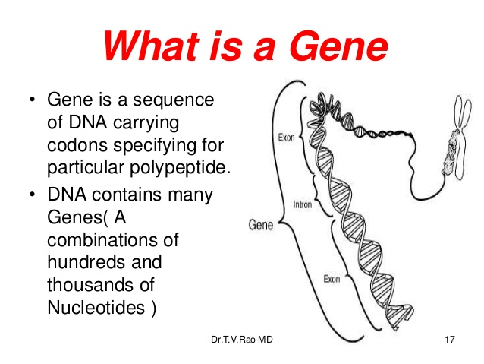

Slide 7
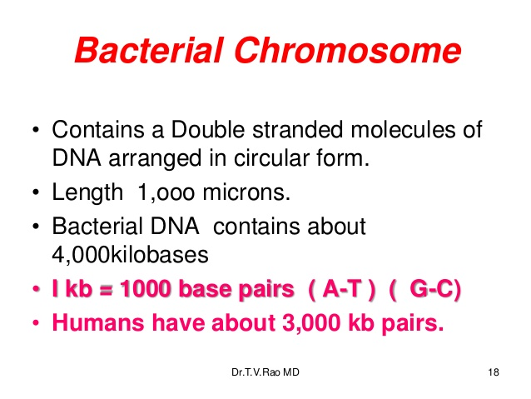


Slide 8
In addition to the single main chromosome
Bacterial cell can carry one or more small circular extracellular elements , much small , supercoiled DNA , self replicant
Are now termed plasmids

Slide 9
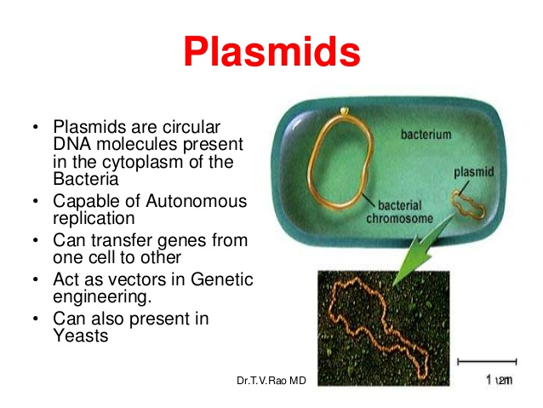

Slide 10
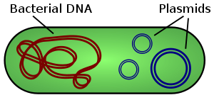

Slide 11
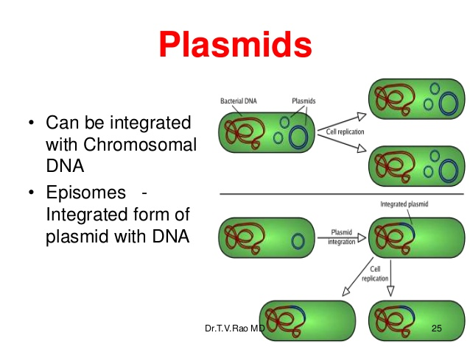

Slide 12
Plasmids characterized by :
Replicate independently
carry supplementry genetic information coding for beneficial properties as
antibiotic resistance

Slide 13
Plasmid can transfer from cell to cell by :
1 – Transduction
2- transformation
3- conjugation
Widely used for cloning DNA

Slide 14
Medical importance :
1- drug resistance
R plasmid (resistance to (antibiotics
2- virulence
Enterotoxin production
antimicrobial agents Production of
4- sex –factor F plasmid ( fertility factor )

Slide 15
Plasmid classification
Because of vast range of plasmids,
Plasmids can be grouped according to :
- properties
- Their spread
- Distribution

Slide 16
The methods for plasmid classification subdivided into :
Physical methods genetic methods

Slide 17
Physical methods
- Centrifugation
- Electrophoresis
The relation between the similar size & confer identical phenotypes can be
examined by generating restriction endonuclease fingerprinting from purified plasmid DNA

Slide 18
DNA molecule at or near to a specific nucleotide sequence to produce DNA fragments which can be separated by gel electrophoresis
The pattern of fingerprint fragments produced is dependent on the distribution of the specific DNA sequences recognized by enzyme
related plasmids will produce the same fingerprint
Unrelated plasmids will produce different fingerprints

Slide 19
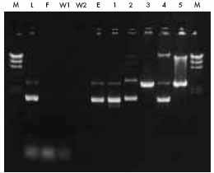

Slide 20
Genetic methods
A final method of plasmid classification by using a
specific virulent bacteriophages

Slide 21
A third source of genetic information in a bacterial cell
can be provided by the presence of certain type of bacterial viruses
Bacteriophages

Slide 22
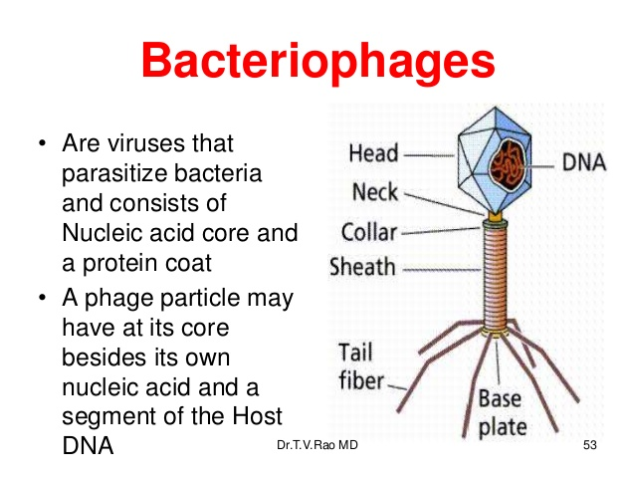

Slide 23
Viral genome ss ( single stranded DNA or RNA
linear circular
they are unable to multiply
in the absence of their bacterial host
lethal to the host cell

Slide 24
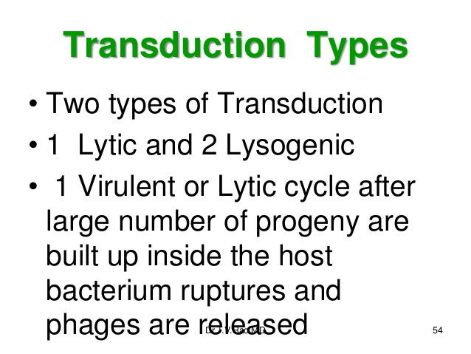

Slide 25
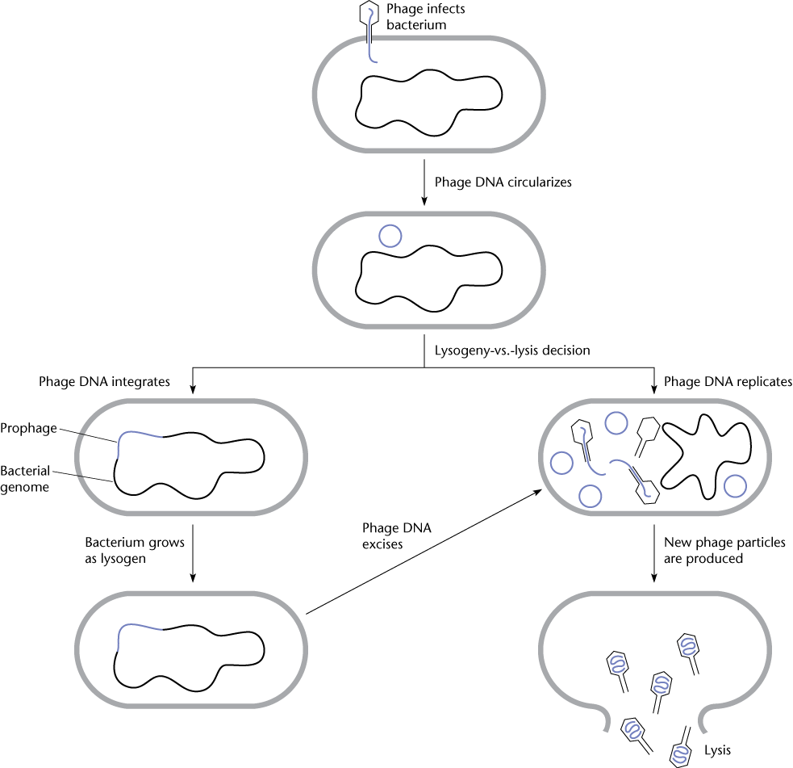
Phage "life" cycles
Virulent phages ("lysis" of bacterial host)
Temperate phages ("lysogeny")
  Lytic phase
  Lysogeny
Lysogeny
Lytic
(DNA Damage)

Slide 26
Controlled replication without causing lysis
called lysogeny
In this case bacteriophages becomes temporary part of the total genetic information

Slide 27
genome size varies 3 - 5000 kilobases Kb

Slide 28
Examples of prokaryotic genetic elements elements
Size Kb | configeration | type | Genetic elements
3 x 103 2x103 | Ds circular Ds circular | DNA DNA | Bacterial chromosome -E.coli - B. subtilis
9 60 | Ds circular Ds circular | DNA DNA | Plasmids -R.300B -RK2
3,6 5,1 40,4 | Ss linear Ss circular Ds linear | RNA DNA DNA | Bacteriophages -MS2 -Φ 174 -17

Slide 29
Functions of Bcteriophages
1- Gene transfer:
Transfer of genetic information from one bacterial strain to another by transduction.
2- Lysogenic conversion:
In which phage s own DNA confers new properties to (the cell. ( Toxignicity of Coryn. Diphtheriae
3- Bacterial typing :
Phage typing is one of the methods used to identify bacteria
4- Genetic engineering

Slide 30
Variation of bacteria
Phenotypic genotypic
mutation gene transfer
phenotypic non phenotypic change
- transformation
- transduction
- conjugation

Slide 31
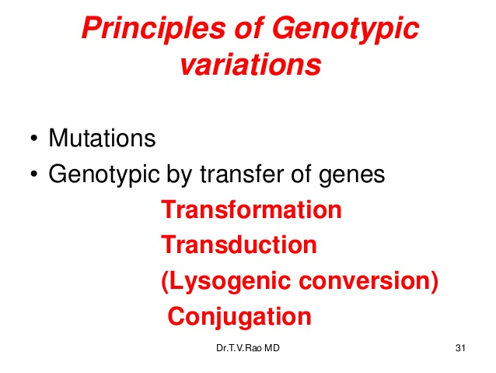

Slide 32
Phenotypic variation
Any change under the influence of environment
reversible
unstable
non heritable
Such as : loss of flagella
loss of cell wall
change of colony appearance ( smooth, rough)

Slide 33
Genotypic variation
irreversible
stable
heritable
due to changes in nucleotide sequences

Slide 34
mutation
the genome is normally identical in all the progeny
Due to asexual binary fission ( bacterial reproduction )
Therefore DNA replication is very accurate
But rarely inaccuracies produce a slight altered nucleotide sequence in one of the progeny cell
Called mutation

Slide 35
Mutation is
Irreversible ) ) stable
Passed to the subsequent generation ) ) heritable

Slide 36
Mutation can occur in 2 ways :
Spontaneously induced by
Rare 1 - 10⁶ using certain
Change of DNA chemical or physical
agents ( mutagens)
- U.V rays
- X- rays
- H2O2

Slide 37
TYPES OF MUTATION
Multisite mutation point mutation
affecting one or very few Extensive chromosomal
rearrangements
Inversion - substitution one to another
one or more Duplication - deletion
Deletion - insertion one or more

Slide 38
Types of mutation
Mutation involving extensive chromosomal rearrangements such as :
A b c d e f g Normal ( wild type )
a b f d e c g 1- inversion
a b c b c d 2- duplication
a b e f 3- deletion
a b x d e f g 4- substituation
a b x c d e f g 5- insertion

Slide 39
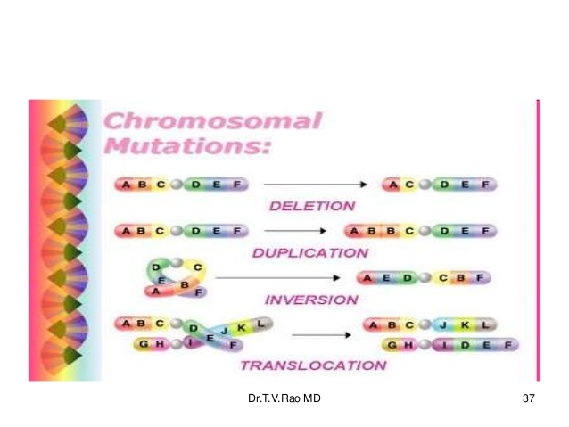

Slide 40
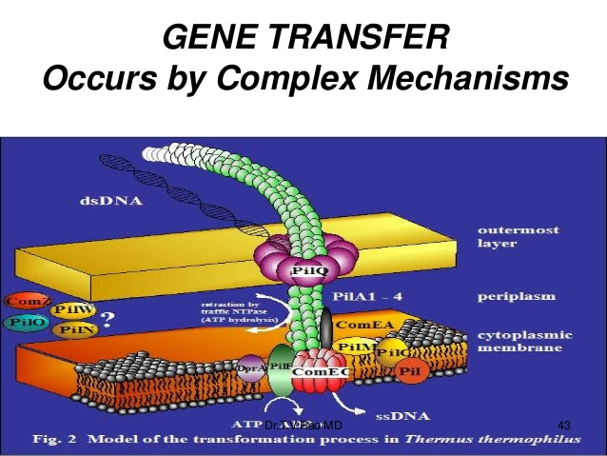

Slide 41
Gene transfer
Change in the genome of a bacterial cell may be caused either by
A mutation in the DNA additional DNA from an of the cell external source
DNA may be transferred between bacteria by
transformation transduction conjugation

Slide 42
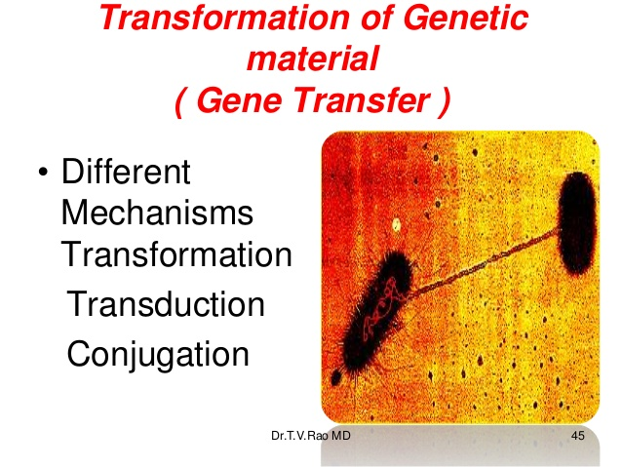

Slide 43
Transformation
Def.:
bacterial cell can take small naked DNA fragments from its surroundings which brings about a genetic change in the recipient cell(
- Certain bacteria as( Bacillus, Haemophilus, Neisseria, Pneumococcus ) can take up DNA from the environment & can be incorporated into the recipient 'chromosome

Slide 44
Factors affecting transformation
DNA size state competence of the
recipient
ds DNA of at least - some bacteria are able to
5x 10⁵ daltons take up DNA naturally only at
Thus, transformation particular time in their growth
is sensitive to nucleases cycle when produce protein
in the environment called competence at this stage the bacteria are said to be competent
- in vitro by treatment with Ca Cl₂
can induced competence to other bacteria

Slide 45
Steps in transformation
1- uptake of DNA
Gram +ve bacteria Gram –ve bacteria
Is taken as ss DNA is taken as dsDNA
The complementary
Is made in the recipient

Slide 46
2 – gene recombination
After the donor DNA is taken up , a reciprocal recombination occurs between the chromosome & the donor DNA
- Recombination requires homology between the DNA& the bacterial recombination genes this called general recombination

Slide 47
3 – significance
Increase virulence widely used in recombinant DNA technology

Slide 48
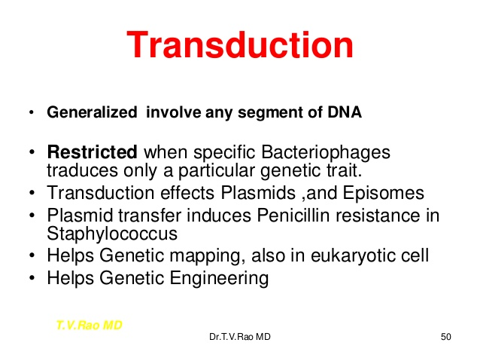

Slide 49
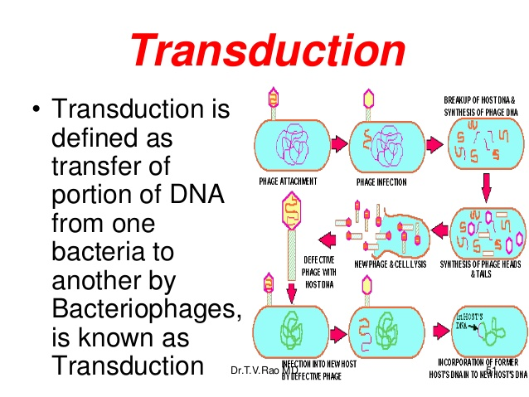

Slide 50
transduction
Some bacteriophages act as vehicles for transfer of genes from one bacterial cell to another .
Bacterial viruses are involved in gene transfer by 3 mechanisms:
Generalized abortive specialized

Slide 51
Generalized transduction
- Generalized transduction is characterized by the transfer of a generalized group of genes
I,e : any gene on the bacterial chromosome have the same chance of being transferred by the viral carrier to
another bacterial cell
- usually follows a lytic attack of a bacteriophage on bacterial cell, bacterial genome undergoes fragmentation often to a virus sized fragments of DNA
Which can be incorporated inside viral capsids ( pseudo – virus) can attack a new cell
- can be mediated by virulent phages or by temeprate phages

Slide 52
Abortive transduction
In many generalized transduction , the segment of DNA from the donor cell fails to be integrated with the recipient chromosome.
The bacterial DNA remains in the cytoplasm , it does not replicate but transmitted to one daughter cell following each division

Slide 53
Specialized transduction
By which a specific set of genes is transferred by temperate phages from one bacterial cell into another
Temperate phages are those capable of integrating their genetic material into the bacterial chromosome ( lysogony)
These phages recombine with the bacterial DNA at precise on the bacterial chromosome

Slide 54
The defective phage :
It misses the viral genes where it left on the bacterial chromosome
- Can not replicate itself because of its missing genes
- Non defective phage must be present in the same cell ( mixed infection) complement the missing segments of the defective virus so that it can be replicated & becomes a transducing phage

Slide 55
Terms used
1 – prophage :
the viral DNA that integrates into the bacterial chromosome
2 – temperate phage :
Viruses that either lyse the cell or behave as a prophage
Can reproduce by 2 mechanisms ( the lytic cycle & the lysogenic cycle)
3 – virulent phage :
viruses that only lyse the cell
4- transducing phage:
It is always defective not able to lysis of the infected cell
Capable of mobilizing bacterial genetic material from one cell to another

Slide 56
Plasmid-mediated conjugation
(conjugation)
Certain bacteria are found to contain plasmids
- plasmid : extrachromosomal dsDNA , circular , it carries genes
Compare between bacterial chromosomes & bacterial plasmids ???
Def of conjugation :
Is the transfer of DNA from a donor to a recipient by direct physical contact between the cells
Donor ( male) & recipient ( female)
The direction of transfer is one way ( donor to recipient)

Slide 57
Mechanism of bacterial conjugation
1- donor cell produce pilus
2 – pilus attaches to recipient cell , brings the 2 cells together
3- the mobile plasmid is nicked & a single strand of DNA is then transferred to the recipient cell
4- both cells recircularize their plasmids, synthesize second strands & reproduce pili, both cells are now viable donors

Slide 58
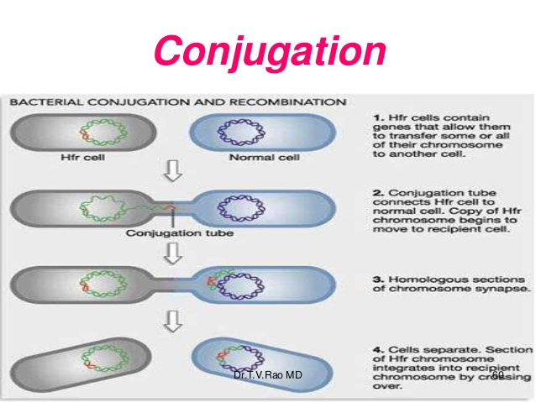

Slide 59
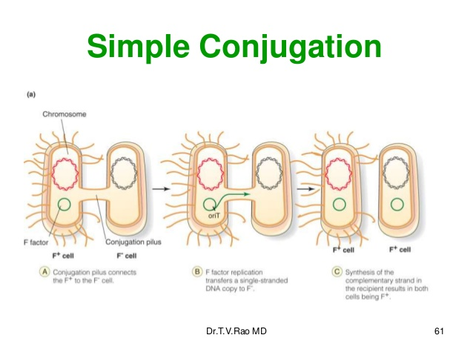

Slide 60
Recombination
Plasmid DNA can be integrated into bacterial chromosome
It is known as episome
N.B.:
Plasmids of gram positive are non transmissible plasmids
I,e they lack self transfer because they lack genes that code for the sex pili

Slide 61
Transposons ( Jumping genes)
These are genetic materials that can move ( Jump or transposon) from one location to another on the same chromosome or from plasmid to plasmid or from plasmid to chromosome and the reverse
They can not autonomously replicate but they replicate with the plasmid or chromosome
Transmissible , Insertion into plasmid can lead to its dissemination

Slide 62
Types:
Simple insertion sequence :
Short DNA sequence that carry genes code only for enzymes responsible for its transposition
Complex transposons:
Which carry genes coding for enzymes responsible for transposition plus antibiotic resistance or toxin production

