Slide 1
- RHABDOVIRIDAE

Slide 2
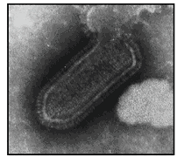
RHABDOVIR1DAE
Rhabdovirus (rhabdos = rod) / (bullet - shaped)
* General properties:
Morphological characters:
• Shape: rod shaped (Cylindrical particles rounded at one end and flat or truncated at the other).
Or it may be conical in shape.
• Size: 75 x 180 nm in size.
• The virus is enveloped.

Slide 3
Genome structure and organization:
• It contains a single stranded, linear RNA of (-) sense (11-15 Kb).
The virion contain five proteins:
Nucleoprotein (N),
Phosphoprotein (P),
Matrix protein (M),
Glycoprotein (G)
Transcriptase (L),

Slide 4
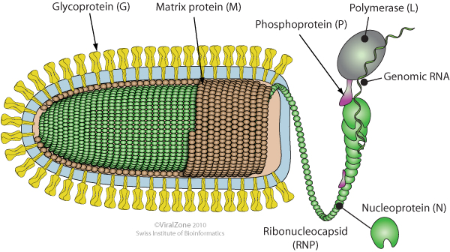
Protein structure:

Slide 5
• The virions are sensitive to ethyl ether and other lipid solvents.
• Rabies virus, VSV, and BEFV possess a lipoprotein haemagglutinin which agglutinates erythrocytes of goose or chicken RBCs.
• They resist freezing and thawing and some members persist in the soil for many days at 4-6°C.

Slide 6
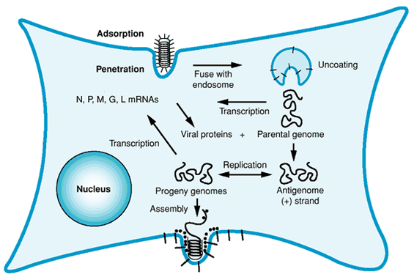
• Virus Replication:

Slide 7
*Classification:
Rhabdoviruses can be classified according to virus properties and serological relationship between them into:
* Genus Iyssavirus:
Contains rabies virus which affect humans and animals.
* Genus vesiculovirus :
Contains vesicular stomatitis virus which affect cattle, Horse and Pig.
* Genus Ephemerovirus :
Bovine Ephemeral fever virus (3-day sickness).
* Genus Novirhabdovirus :
Contain infectious hematopoietic necrosis virus which affect fish.
Host | Species | Genus
Human and Animals | Rabies virus | Lyssavirus
Cattle, Horse and Pig. | vesicular stomatitis virus | Vesiculovirus
Cattle and Buffaloes | Bovine Ephemeral fever virus | Ephemerovirus
Fish | infectious hematopoietic necrosis virus | Novirhabdovirus

Slide 8
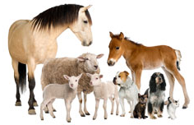
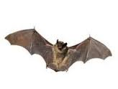
GENUS LYSSAVIRUS
RABIES
An infectious disease of man and animals caused by rabies virus transmitted through the bite of rabid animal to other animals resulting in a rapidly fatal encephalomyelitis.
* Hosts affected:
Man and all warm - blooded animals including birds are susceptible to rabies virus.
Dogs, cats, cattle and wild carnivores as fox are mostly affected.
Vampire bats also act as natural host of the virus.

Slide 9
* Haemagglutination:
Rabies virus produce haemagglutinins when propagated on BHK-21 cells, maintained in media containing 0.4% bovine albumin and no serum.
There is no neuraminidase enzyme.
The optimum conditions for HA test:
low temperature 4°C and low pH (6.2).
one day - old chick or goose RBCs
serum (inhibitor) free medium.
The rabies haemagglutinin - inhibitors is present in high titer in sera of many mammals and is difficult to remove even after adsorption by 25% kaolin at pH 9.

Slide 10
Physicochemical characters:
•The virus resist:
  autolysis and putrefaction (7-10 days in autolysed brain tissues).
  Nervous tissues in 50%glycerol for months .
•Temperature:
Resist in 4°C for several weeks and at lower temperatures for many months and lyophilization.
Inactivated by repeated freezing and thawing.
Labile at room temperature after only a few days.
Inactivated by boiling for 2 min. and at 56°C for 15-30 minutes.
• Inactivated by:
•Exposure to UV, proteolytic enzymes, acid pH, bile salts, formalin and 20% ether.
•Exposure for 15 minutes to 1% formol, 3% cresol or 0.1% mercuric chloride.
•Preservation: PBS at pH 7-9 containing 2% inactivated normal guinea -pig serum or 0.75% bovine albumin, -70°C .

Slide 11
*Antigenic properties:
Surface glycoproteins (G) are the type specific Ag, induce production of neutralizing antibodies that cause protection of animals against subsequent challenge with rabies virus.
All strains of rabies virus are antigenically homogeneous, detected by SNT.
Antigenic relationship between rabies virus and other lysaviruses and rhabdoviruses was recgnized using FAT and AGPT.

Slide 12
According to the host adaptation there are two types of Rabies virus strains:
* Street virus:
Strains of rabies virus occurring in animals under natural conditions, form a complete antigenic community,
But differ from each other in terms of :
Virulence,
Length of incubation period and
Type of histological lesions produced.
They also vary in their fixation:
Some become fixed immediately,
Others after 50-60 passages and
Some not at all.

Slide 13
* Fixed virus:
Fixed viruses can be produced by serial passage of street rabies virus in other animals.
Different strains of street virus vary in their virulence and also in the capacity to become fixed (The more virulent the viruses, the easier they become fixed).
Dogs inoculated intracerebrally with a suspension of brain from a rabid dog developed typical rabies after an incubation period of 1-2 weeks and died within 3 Weeks.
The same material inoculated into rabbits produced paralysis, followed by death, in about 14-19 days.
After 40 – 80 serial intracerebral passages the incubation period was reduced to about 7 days.

Slide 14
Due to irreversible changes occurred in the biological properties fixed virus is characterized by:
Shortening of incubation period (4- 9 days in rabbits).
Increased neurotropic affinity for rabbit and regularity of symptoms (paralytic form).
Failure to produce typical Negri bodies.
Increased virulence for its host (rabbits) but decreased virulence for other animal species (used as vaccine).

Slide 15
* Cultivation:
1- Chicks:
Flurry strain (virus isolated from brain and salivary and lacrymal glands of a girl dead from rabies) was inoculated intracerebrally into I-day-old chicks that caused paralysis after 30 days.
Serial passage in baby chicks decreased incubation period to 6 days and the pathogenicity of the virus was greatly reduced for mammalian host.
At the chick passage level 136 the flurry strain was adapted to the 7-day-old developing chick embryo (fertile eggs).

Slide 16
2- Fertile egg:
Street rabies viruses were difficult to cultivate in fertile eggs due to their highly specific neurotropism, unless they were first propagated in one day old chick.
During serial egg passage the virus change form neurotropic to pantropic (spread extraneurally to the embryonic tissues).
•Low egg passage (LEP):
Virus passage for 40-50 times in fertile egg.
A single intramuscular injection of this virus produced immunity in dogs without harmful effects.
•High egg passage (HEP):
The virus passage for 180 times in fertile eggs.
It produces immunity in cattle and humans, given by intramuscular route.
A modified avianised strain similar to that of the flurry virus was developed and designated as the kelev strain.

Slide 17
3- Mice or hamsters (3-6 weeks) :
Animals inoculated intracerebrally with signs of infection appeared 6-8 days post -inoculation, which include muscular tremors, in coordination of gait, paralysis and terminate in death.
while-survival for 3 weeks is generally interpreted as a negative diagnosis.
4- Tissue culture:
The virus propagated in a wide variety of cell types, as primary and continuous cultures of chick embryo, mouse, hamster, pig, rabbit, dog and human cells.
Higher titers are obtained in BHK21, WI38
The virus is cell associated and replicate in cytoplasm make intracytoplsamic Inclusion bodies.

Slide 18
Laboratory diagnosis
The preferred samples:
Brain tissues (portions of the hippocampus, cerebellum and cerebral cortex from each side) placed in 50% glycerol-saline to preserve the virus.
Saliva, salivary gland tissue can be used for mice inoculation.
Direct demonstration:
1- FAT on impression smears from brain fixed in acetone – free methyl -alcohol and dried at room temperature.
2- Microscopically demonstration of Negri bodies on impression smears from brain or histological section stained with Sellers' stain.
(Intracytoplasmic Negri body recognized as rounded reddish purple mass with dark blue to black basophilic inner granules clustered within its matrix).

Slide 19
Virus Isolation:
1- Mice or hamsters (3-6 weeks) :
Animals inoculated intracerebrally with signs of infection appeared 6-8 days post -inoculation, which include muscular tremors, in coordination of gait, paralysis and terminate in death (Survival for 3 weeks considered negative).
Mouse brain examined microscopically for presence of Negri bodies especially in mice showing paralysis for 24 hours before death.
2- Tissue culture:
The virus propagated in BHK21, WI38 with CPE as cell rounding and then lysis.
The virus is cell associated and replicate in cytoplasm make intracytoplsamic Inclusion bodies.

Slide 20
*Confirmatory diagnosis:
1- SNT for detection of neutralizing antibodies.
2- FAT: It is rapid and highly specific means for detection of viral antigen in infected dog, inoculated mice and tissue culture.
FAT detect of viral antigen in epithelial cells of corneal smears and on impression smears from brain of inoculated mice several days before death.

Slide 21
Control of rabies
Prophylactic vaccination is one of the most important ways for control of rabies.
*Flurry LEP vaccine:
*Flurry HEP vaccine:
*Rabbits spinal cord vaccine:
*Fermi and semple phenolized fixed -virus vaccine:
*Inactivated nervous -tissue vaccines:
* Reck's duck - embryo vaccines:
* Purified rabies vaccines (PRV):
*Tissue culture adapted vaccines:
Now a highly purified tissue culture adapted inactivated rabies virus vaccines used for human and animals.
Rabies is a notifiable public health disease with strict control measures applied.

Slide 22
BOVINE EPHEMERAL FEVER
(THREE- DAYSICKNESS)
An arthropod – borne virus disease of cattle and buffaloes characterized by sudden fever, stiffness, lameness and spontaneous recovery within few days.
*Hosts affected: Cattle and buffaloes.
*General properties:
The virus possesses some of the characteristics of Rhabdoviruses.
Citrated whole blood from affected cattle remains infective for 8 days when stored at 2-4°C.
The virus can be stored for years at - 70°C in lyophilized state at 4°C.
Low pH (2.5) or high pH (12) destroys the infectivity of the virus within 10 minutes.
The virus is inactivated at 56°C within 10 minutes, 37°C within 18 hours at 25°C in 120 hours.

Slide 23
Laboratory diagnosis:
- The preffered sample is the buffy coat from citrated blood samples .
The virus also can be detected in cells from lungs, spleen and LN.
- Virus isolation:
* Cultivation:
- Lab. animal:
The virus has been adapted to growth in the brain of unweaned mice or hamsters (1-3 days age).
Virulent strains become stabilized after only 6 serial intracerebral passages, causing paralysis and death 2-3 days post inoculation.
The virus loss of pathogenicity for-calves.
-Tissue culture:
The virus can also be grown in BHK-21 and Vero cells with the CPE develop after 48 hours of incubation which is characterized by granular cytoplasm, cell rounding followed by detachment from the glass

Slide 24
- Confirmatory diagnosis:
The most reliable methods for viral detection are FAT, ELISA, Immunoperoxidase, neutralization test and RT-PCR.
*SNT, ELISA and CFT for antibody detection (one serotype) but considered of diagnostic value only when taken in conjunction with clinical signs of disease.
*Immunity:
Recovered cattle are immune for up to 2 years.
Many viral vaccines were tried.

