Slide 1
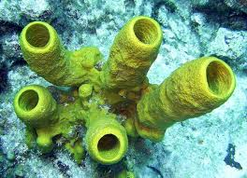
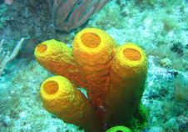
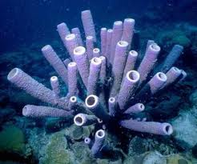
Subkingdom: Parazoa Phylum: Porifera (The Sponges)
This includes a single phylum, Porifera, the members of which are simple multicellular animals commonly known as sponges. The body of the animal is formed of many cells which are not much differentiated and do not form proper tissues.

Slide 2
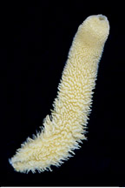
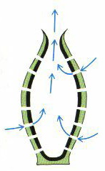
General Characters of Porifera (The Sponges)
Aquatic animals; mostly marine, a few freshwater; occur singly or in colonies.
Shape mostly variable, radially symmetrical or asymmetrical.
All are filter feeders. The body surface is perforated by numerous pores (ostia) from which the water current enter the body cavity then exite from the oscula.

Slide 3
General Characters of Porifera (Cont.)
4. Dibloblastic, whose bodies are made up of ectoderm and endoderm.
Body multicellular, hardly formed into true tissues, without definite organs or systems.
Sponges are built up from relatively few cell types, the main ones being choanocytes, pinacocytes, amoebocytes, porocyte and sclerocytes.

Slide 4
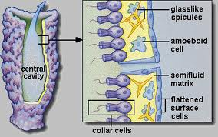
General Characters of Porifera (Cont.)
Some or all of the interior spaces of the body are lined with special collared, flagellated cells, the choanocytes. The water current is circulated by the choanocytes flagella, brings in food and oxygen and carries away the excretory and reproductive products.
Mouth and a digestive system are absent. The choanocytes ingest minute animals and plants. Digestion entirely intracellular as in the Protozoa. The amoebocytes serve food storage.
The nervous and sensory cells are altogether absent.
Respiration takes place by simple diffusion between the flowing water and the cells.

Slide 5
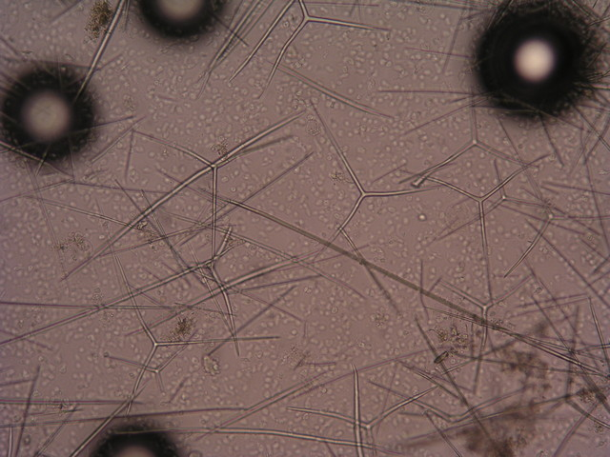
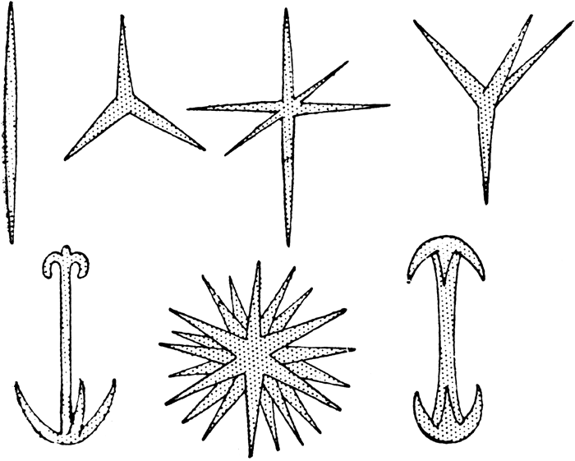
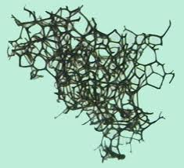
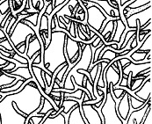
General Characters of Porifera (Cont.)
11. The skeleton is internal and supported by spicules (formed of silica or calcium carbonate), sponging fibres or both.
Spicules
Spoingin fibres

Slide 6
General Characters of Porifera (Cont.)
Excretion of wastes and nitrogenous material leave the body with the outgoing water current from the osculum.
The adults are sessile but the larval stages are free-swimming.
All possess great powers of regeneration.
Both hermaphrodite and unisexual forms exist. Reproduction occurs both asexually by budding, regeneration and gemmules formation and sexually by ova and sperms (male and female gametes). The ova and sperms developed from the amoebocytes.
Fertilization is internal and cleavage holoplastic.

Slide 7
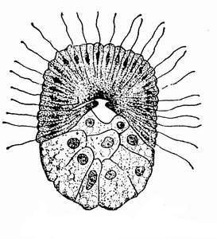
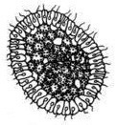
General Characters of Porifera (Cont.)
Development is indirect. The embryo leaves the sponge as an actively swimming ciliated larva, which finally attaches itself in the substratum and undergoes metamorphosis to reach the adult stage. The larvae are of two types, the amphiblastula and the parenchymula.
The Porifera are classified into 3 classes according to the nature of the skeleton (Calcarea, Hexactinellida and Demospongia).

Slide 8
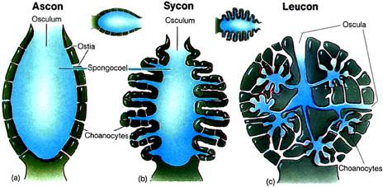
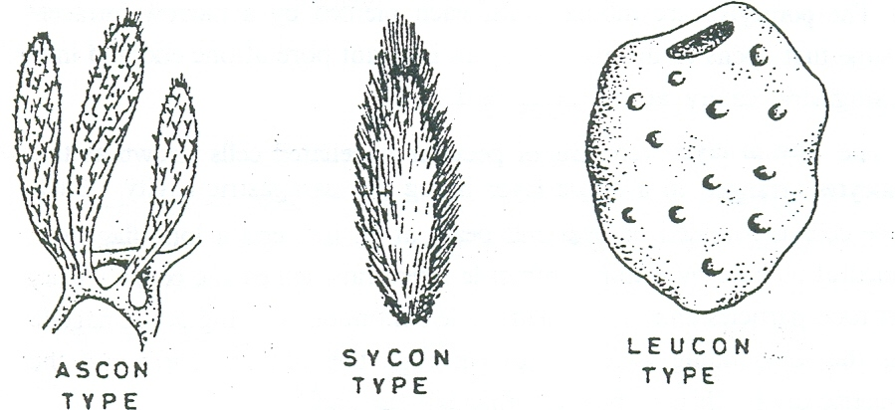
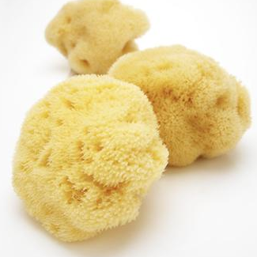
General Characters of Porifera (Cont.)
19. There are three structural types of sponge:
a) Ascon type: is a simple sponge (e.g. Leucosolenia).
b) Sycon type: is a sponge of more complexity than ascon (e.g. Sycon).
c) Leucon type: is the most complex type of sponges (e.g Euspongia or bath sponge).

Slide 9
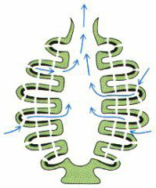
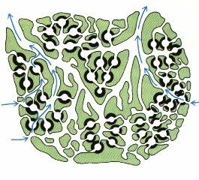
Water Curent, Nutrition, Respiration and Excretion

Slide 10
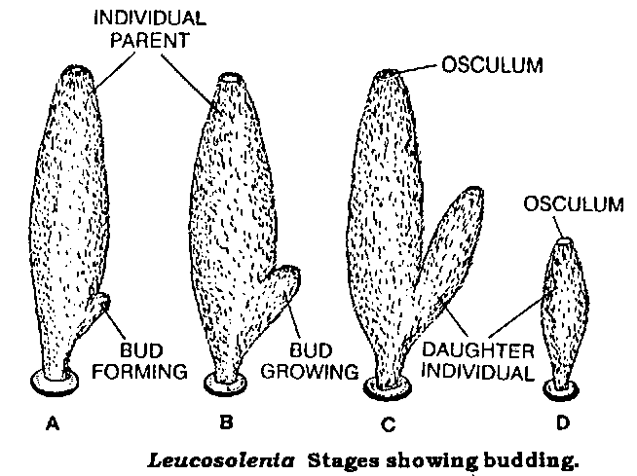
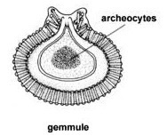
Reproduction
A- Asexual:
Regeneration:
Budding:
Gemmule formation:

Slide 11
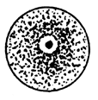
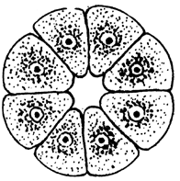
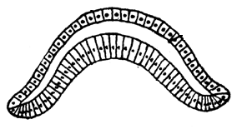
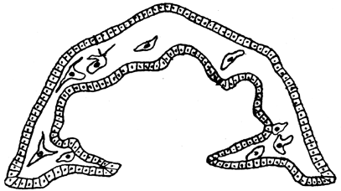
Reproduction
B- Sexual:
1
2
3
4
5
Porifera development (1- fertilized zygot, 2- hollow sphere blastula stage, 3- mobile stage amphiblastula larva, 4- gastrula, 5- settled down and development of different cells).

