Slide 1
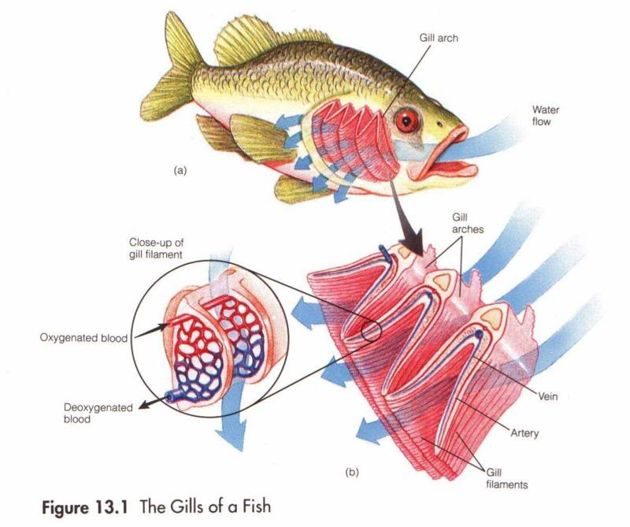
GILLS Histology

Slide 2
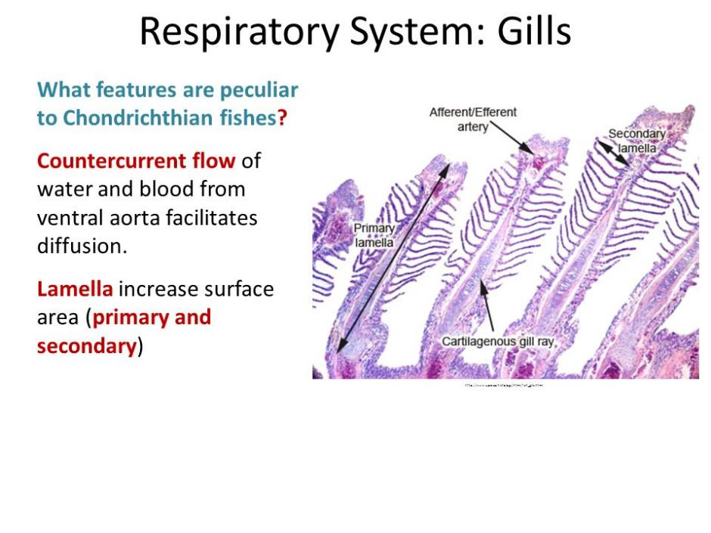

Slide 3
Normal Teleost gill form (anatomy)
‘Branchia’ in greek = ‘gills’
In bony fish (Teleosts):
  Gills lie in a branchial cavity covered by the operculum:
    Usually two sets of four holobranchs
    Each holobranch consists of two hemibranchs (‘half gill’):
      Anterior and posterior
    Hemibranchs consist of a row of long filaments (primary lamellae) with semilunar folds (secondary lamellae).
Lamellae or filaments:
  Connective tissue scaffold (epithelial cells) framing a vascular network providing blood flow primarily used for gas and ion exchange.
  Primary and secondary.
Notes:
It is important that we understand the design and normal structure of fish gills, so lets quickly review the anatomical features of this specialised organ.
‘Branchia’ in Greek means gills and in bony fish (teleosts) = the gills lie in a branchial cavity covered by the bony operculum (gill cover).
There are usually two sets of four holobranchs in teleosts = one set on the left and one on the right.
Each holobranch consists of two hemibranchs (half gills) = and these are divided into anterior (front hemibranch) and posterior (back hemibranch).
Hemibranchs consist of a row of long filaments known as primary lamellae with numerous semi-lunar folds known as secondary lamellae = I WILL SHOW YOU A DIAGRAM OF THIS SHORTLY.
Lamellae are also know as gill filaments = and these are connective tissue scaffold of epithelial cells that frame a vascular network supplying blood for gas and ion exchange.

Slide 4
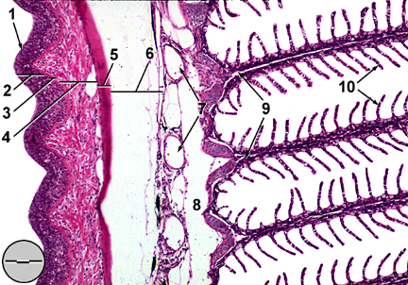
1. gill raker;
2. mucosal epithelium; 3. basement membrane; 4. submucosa;
5. bone;
6. adipose tissue;
7. efferent branchial arterioles;
8. afferent branchial artery;
9. primary lamellae; 10. secondary lamellae.

Slide 5
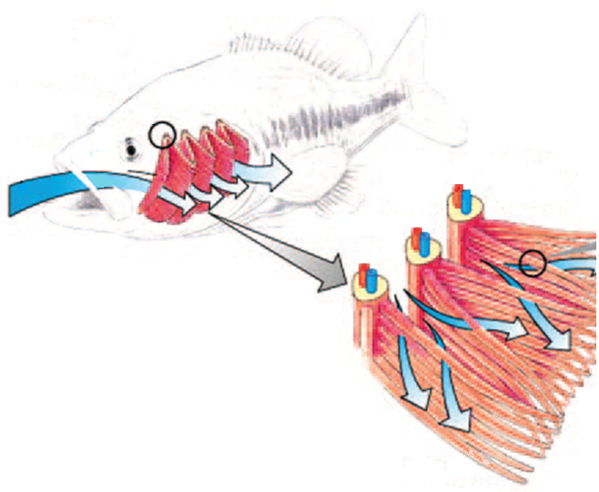
Teleost gill structure
Holobranch
Gill filaments
Hemibranch (anterior)

Slide 6
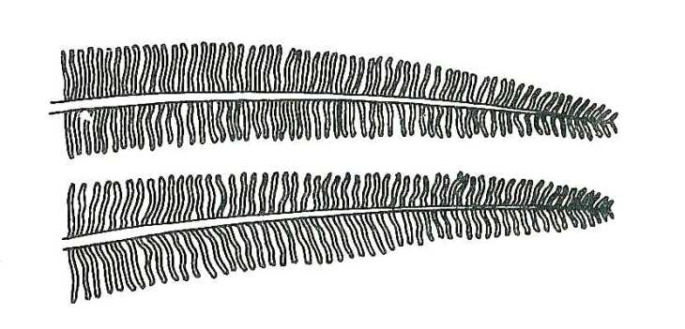
Gill lamellae
Secondary lamellae
Primary lamellae
Notes:
This is a close up diagram of the gill lamellae; you can see the long primary lamellae here and the secondary lamellae branching off.

Slide 7
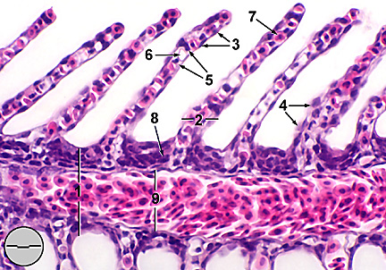
GILLS structure
1. primary lamella; 2. secondary lamella; 3. epithelial cell;
4. mucous cell; 5. pillar cell; 6. lacuna (capillary lumen); 7. erythrocyte
within capillary lumen; 8. undifferentiated basal cell; 9. central venous sinus
Notes:
At closer magnification again, you can identify clearer the secondary lamellae.
Notice how the filament is approximately one cell thick
And that the filaments are not touching each other
1 = Primary lamellae = central cartilaginous support, afferent and efferent arterioles and epithelial covering.
2 = Secondary lamellae = thin epithelial covering where gas exchange occurs.
3 = Epithelial cells =
4 = Mucous cells
5 = Pillar cells = contractile cells that control lacuna diametre thus regulate blood flow.
6 = Lacuna = spaces between pillar cells that connect afferent and efferent arterioles.
7 = Erythrocyte within capillary lumen = fish red blood cells are nucleated
8 = Undifferentiated basal cell
9 = Central venous sinus

Slide 8
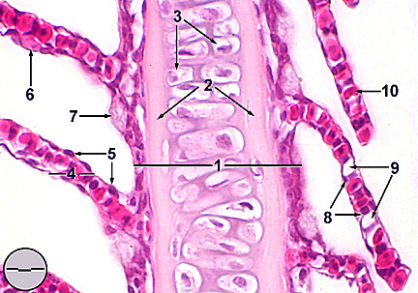
1. primary lamella
; 2. extracellular cartilaginous matrix; 3. chondrocytes;
4. secondary lamella; 5. epithelial cell;
6. mucous cell;
7. chloride cell;
8. pillar cell;
9. lacuna (capillary lumen);
10. red blood cells within lacuna.

Slide 9
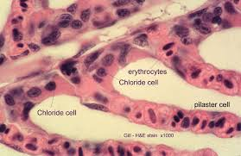

Slide 10
Normal Teleost gill function
Gill functions:
Gaseous exchange = O₂ via 2º lamellae.
Acid-base balance = equilibrium between acidity/alkalinity.
Osmoregulation = adjustment of internal osmotic pressure in relation to surrounding medium.
Excretion of nitrogenous waste = ammonia.
Gills sensitive to a range of environmental pollutants.
Gaseous exchange = secondary lamellae:
Consist of an envelope of epithelial cells
Usually one layer thick
Supported/separated by specialised cells:
  Pillar cells = regulate blood flow.
  Chloride cells = maintain internal ionic homeostasis.
Notes:
Gills have numerous functions; and as a consequence they are susceptible to a range of environmental pollutants!
The main function is for gaseous exchange via the secondary lamellae
The secondary lamellae are important structures and consist of an envelope of epithelial cells (cells lining the surface)
Usually one cell layer thick
And are supported by specialised cells such as pillar and chloride cells.
WE WILL HAVE A LOOK AT SOME HISTOLOGY OF THE SECONDARY LAMELLAE IN A MINUTE.

Slide 11
References
Deeds, J.R., Reimschuessel, R. and Place, A.R. (2006). Histopathological Effects in Fish Exposed to the Toxins from Karlodinium micrum. Journal of Aquatic Animal Health. 18(2), 136-148.
Evans, D.H., Piermarini, P.M. and Choe, K.P. (2005). The Multifunctional Fish Gill: Dominant Site of Gas Exchange, Osmoregulation, Acid-Base Regulation, and Excretion of Nitrogenous Waste. Physiological Review: 85, 97–177.
Hallegraeff, G., Mooney, B. and Evans, K. (2010). What triggers Fish-Killing Karlodinium veneficum Dinoflagellate Blooms in the Swan Canning River System?. Swan Canning Research and Innovation Program.
H.W. Ferguson. (2006). Systemic pathology of fish. A Text and Atlas of Normal Tissues in Teleosts and their Responses in Disease. Scotian Press, London.
McGavin, M.D. and Zachary, J.F. (2007). Pathological basis of Veterinary Disease. 4th Ed. Mosby Elsevier, Miissouri.
Roberts. R.J. (1989). Fish Pathology. 2nd Ed. W.B. Saunders, London.
University of Maryland College Park Campus, Aquatic Pathobiology Centre, Virginia-Maryland Regional College of Veterinary Medicine, Atlas of Flathead Minnow Normal Histology. Retreived from the World Wide Web August 2012:
http://aquaticpath.umd.edu/fhm/resp.html

