Slide 3
JAUNDICE

Slide 4
BY
Dr. Samy Ali Hussein Aziza
Professor of Biochemistry and Clinical Biochemistry
Faculty of Veterinary Medicine, Moshtohor, Benha University, Egypt.
E.Mail:Samyaziza@yahoo.com

Slide 5
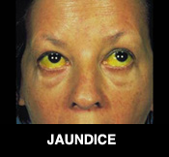
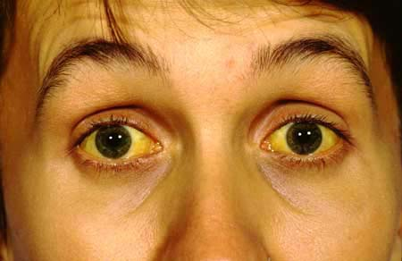
JAUNDICE
Jaundice (also called icterus) is a condition characterized by a yellow discoloration of the skin, sclera (whites of the eyes), and mucous membranes. It caused by deposition of bilirubin secondary to increased bilirubin levels in the circulation.

Slide 6
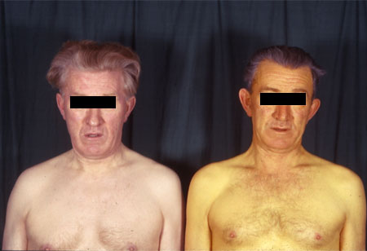
It can be caused by other yellow substances such as carotene or certain drugs.
Conjugated bilirubin causes more jaundice than unconjugated bilirubin because of its easier absorption into tissues and higher water solubility.

Slide 7
Types of jaundice
Jaundice can be classified into three major forms:
Hemolytic jaundice (prehepatic).
Hepatocellular jaundice (Hepatic).
Obstructive jaundice (Posthepatic).
In both prehepatic and posthepatic jaundice, the function of the liver itself is not impaired.

Slide 9
I. Hemolytic jaundice (Prehepatic)
The liver has the capacity to conjugate and excrete over 3000 mg bilirubin per day, whereas the normal production of bilirubin is only 300 mg/day.
This excess capacity allows the liver to respond to increased heme degradation with a corresponding increase in conjugation and secretion of bilirubin diglucuronide.

Slide 10
Prehepatic jaundice is caused by an increased production of bilirubin by the body.
There are four general causes:
Excessive destruction of circulating erythrocytes (hemolysis)
Ineffective erythropoiesis, resulting in an increased rate of destruction of immature and malformed red cells.(Ineffective erythropoiesis is a pathologic process in which a very low proportion of red cells formed in the bone marrow enters the circulation and those remaining in the bone marrow are prematurely destroyed).
Increased turnover of nonhemoglobin heme compounds in the liver and other organs.
Phagocytic breakdown of extravasated red blood cells (hematoma).

Slide 11
Increased hemolysis may be due to:
Hemolytic anemias.
Exposure to chemicals.
Hemolytic antigen-antibody reactions.
Disease states (some cancers).
Drugs coating red blood cells.

Slide 12
Massive lysis of red blood cells (for example, in patients with sickle cell anemia or malaria) may produce bilirubin faster than the, liver can conjugate it.
More bilirubin is excreted into the bile.
The amount of urobilinogen entering the enterohepatic circulation is increased
Urinary urobilinogen is increased.
Unconjugated bilirubin is elevated in blood.

Slide 13
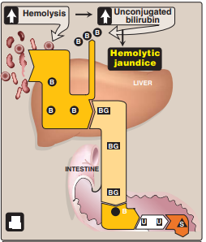
In prehepatic jaundice, the production of bilirubin is below the capacity of the liver to conjugate and excrete it.
In prehepatic jaundice no bilirubin found in the urine because the increase is in unconjugated bilirubin (not filtered through the glomerulus).

Slide 14
II. Hepatocellular jaundice (Hepatic)
Damage to liver cells (for example, in patients with cirrhosis or hepatitis) causes a decrease in both bilirubin uptake and production of conjugated bilirubin.

Slide 15
Hepatic Jaundice can be subdivided into two types:
Retention jaundice: defect in the transport of bilirubin into the hepatocyte.
Regurgitation jaundice: the hepatic cell is damaged or defective or the excretion of products from the hepatocyte is impaired.

Slide 16
In retention jaundice, unconjugated bilirubin is the predominant type found in the plasma.
Conjugation enzyme deficiencies, as in Gilbert’s disease and Crigler-Najjar syndrome, are examples of retention jaundice.
In regurgitation jaundice, conjugated bilirubin is found in greater concentrations.
Dubin-Johnson syndrome, Rotor’s syndrome, viral hepatitis, and toxic and neoplastic conditions are examples of regurgitation jaundice.

Slide 17
Unconjugated bilirubin occurs in the blood.
Increased urobilinogen in the urine.
The urine is dark in color and stools are a pale, clay color.
Plasma levels of AST (SCOT) and ALT (SGPT) are elevated and the patient experiences nausea and anorexia.

Slide 18
III. Obstructive jaundice (Posthepatic)
Posthepatic jaundice, or obstructive jaundice, caused by a blockage of the flow of bile from the liver.
Bile produced by the liver cannot be released into the intestines and overflows.
Jaundice is not due to overproduction of bilirubin, but results from obstruction of the bile duct.

Slide 19
For example:
The presence of a hepatic tumor of bile stones may block the bile ducts, preventing passage of bilirubin into the intestine.
The liver "regurgitates" conjugated bilirubin into the blood, which is excreted in the urine.
Patients with obstructive jaundice experience GI pain, nausea, and produce stools that are a pale, clay color.

Slide 20
The Cause of most common obstructions are:
Stones within the common bile duct.
Neoplasm of the pancreas or other organ.
Strictures caused by congenital defects in the ducts or by trauma to the ducts during abdominal surgery.
Note: Prolonged obstruction of the bile duct can lead to liver damage and a subsequent rise in unconjugated bilirubin.

Slide 21
Posthepatic jaundice characterized by:
Increase plasma conjugated bilirubin.
The quantity of bilirubin reaching the intestines is decreased resulting in the characteristic clay-colored feces. due to the decreased formation of urobilinogen in the intestines and its decreased excretion.
very little or no urobiliogen but large quantities of bilirubin in the urine.
yellow-orange urine color reflects excretion of bilirubin.

Slide 22
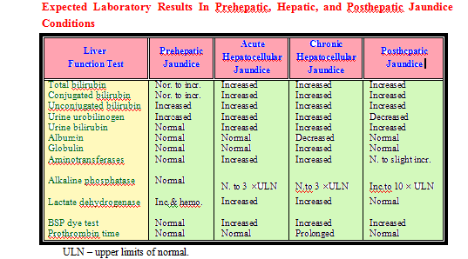

Slide 23
IV-Neonatal jaundice
Neonatal jaundice is a condition defined as the newborn having total serum bilirubin levels above 15 mg/dL in the few days after birth or bilirubin levels persisting above 10 mg/dL for more than 2 weeks.
The newborn have higher bilirubin concentration than adult because of the hemolysis occurring during birth as well as the infant’s immature liver.

Slide 24
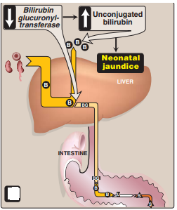
Newborn infants, particularly premature babies, often accumulate bilirubin because the activity of hepatic bilirubin glucuronyl transferase is low at birth and reaches adult levels in about two weeks.
Elevated bilirubin, in excess of the binding capacity of albumin, can diffuse into the basal ganglia and cause toxic encephalopathy.

Slide 25
Neonatal jaundice

Slide 26
Cause:
Before birth the fetus depend on the mother’s liver to perform the necessary functions.
The enzymes necessary for metabolism and conjugation are not present in sufficient concentrations at birth and do not function efficiently for a few days later.
These two conditions, as well as an increased rate of absorption of unconjugated bilirubin from the infant’s intestinal tract, often cause bilirubin levels to rise to 10 mg/dL
Medical treatment to help the removal of excess bilirubin and to prevent the development of kernicterus.

Slide 27
Kernicterus:
It is the deposition of unconjugated bilirubin in the central nervous system that may cause severe neurologic damage.
Several pathologic conditions cause these symptoms to continue such as:
Biliary atresia.
ABO blood group system (is used to represent the presence of one, both, or neither of the A and B antigens on erythrocytes).
Rh incompatibility.
Septicemia.
Neonatal hepatitis.
Inherited metabolic liver diseases.

Slide 28
Treatment:
Administration of Phenobarbital to induce enzyme activity or phototherapy with monochromatic blue light to cause the oxidation of bilirubin to more soluble end products and enhance the renal excretion of the bilirubin.
Thus, newborns with markedly elevated bilirubin levels are treated with blue fluorescent light, which converts bilirubin to more polar and, hence, water-soluble isomers.
These photoisomers can be excreted into the bile without conjugation to glucuronic acid.

Slide 29
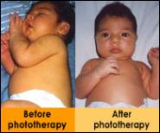
Neonatal jaundice light treatment

Slide 30
