Slide 1
Development of Nervous system

Slide 9
Development of Spinal cord

Slide 10
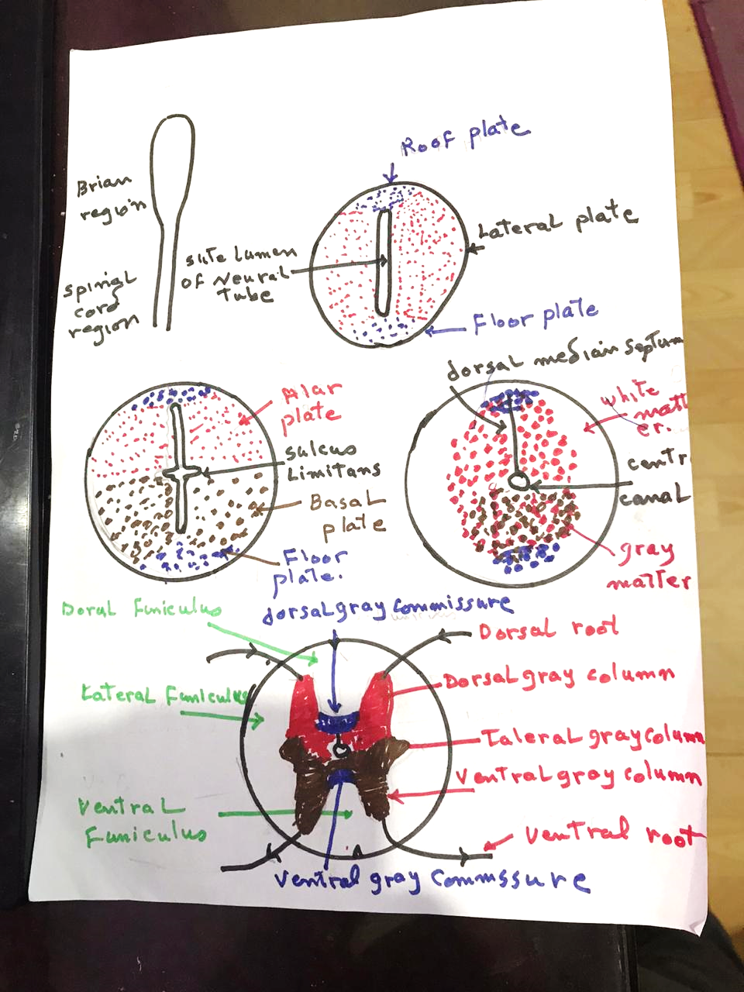

Slide 11
Development of Eye

Slide 12
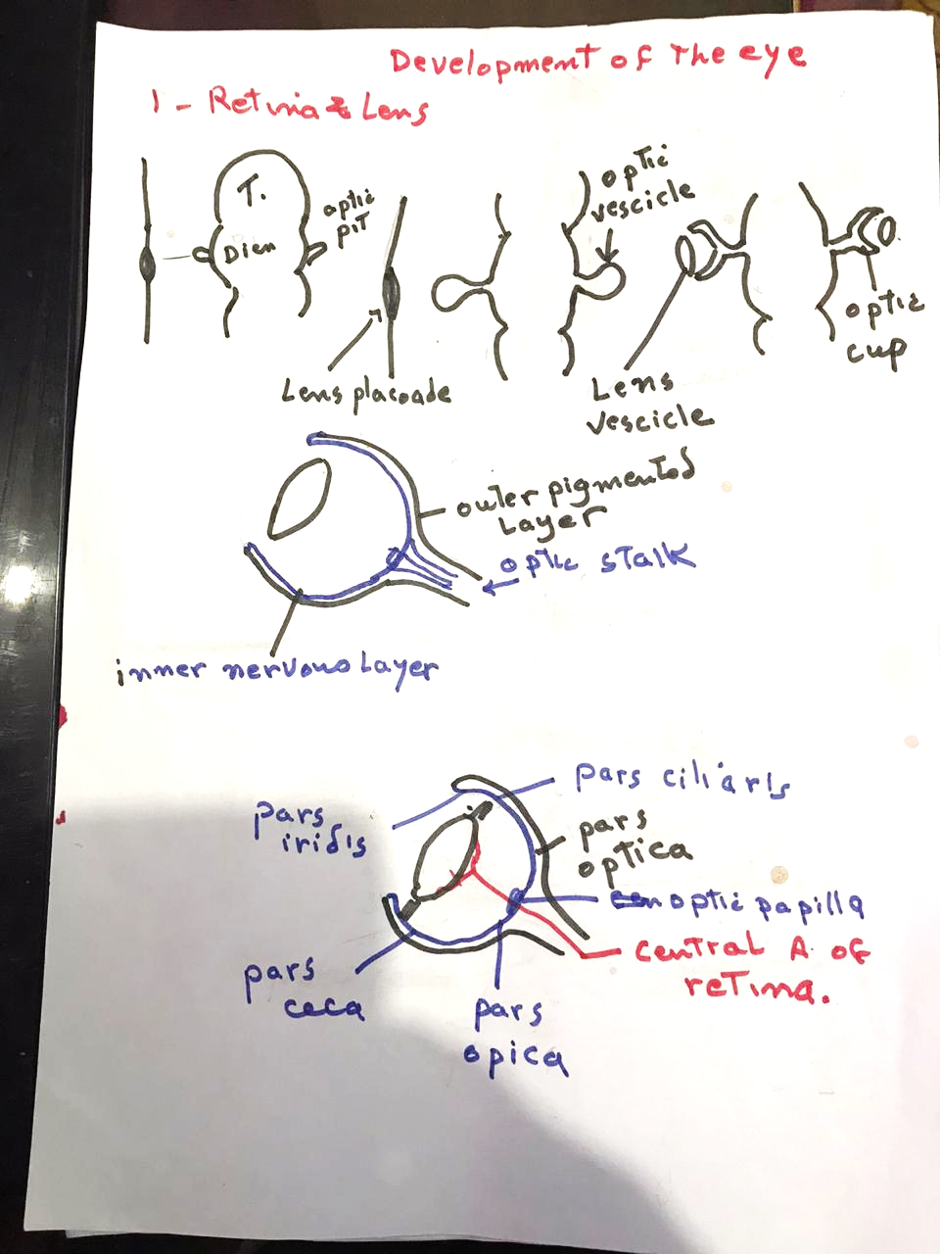

Slide 13
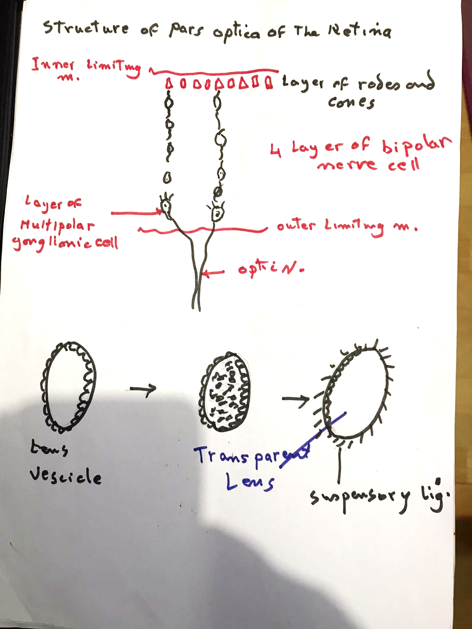

Slide 14
