Slide 1
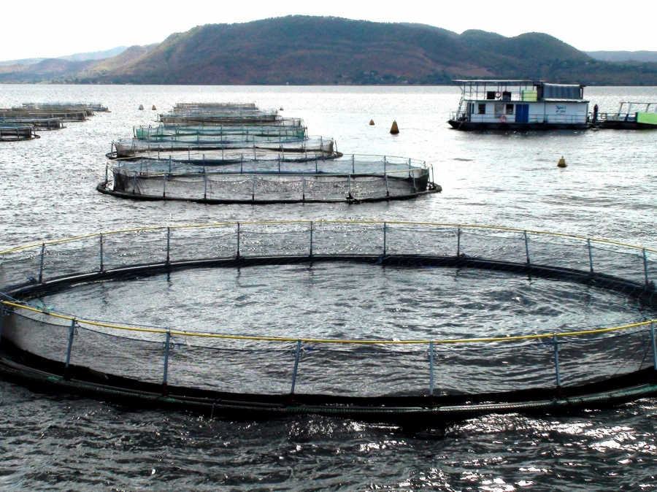
Fish nutrition in aquaculture

Slide 2
Fish nutrition in aquaculture
Aquaculture
The Farming of aquatic organisms including fish, molluscs, crustceans, and aquatic plants.
Total aquaculture production in 1990 was just over150 million tones.
Historically, Asia is considered to be the cradle of aquaculture.
Asia contribute about 85% of the total production followed by Europe (about 7-10%).
Approximately 150 countries in the world are known to have some sort of aquaculture activity.
China is leading producer of all aquaculture commodities, it had long history and tradition of utilizing its water resources and fish species.

Slide 3
Differences between nutrition and feeding of fish and land animals
Fish need proteins, essential fatty acids, minerals, vitamins and energy sources.
Energy requirements are relatively lower than warm land animals
Fish have higher protein to energy ratio.
Ability of fish to absorb certain minerals such as calcium from water surrounding them reduce the dietary needs for these minerals.
Some fish have a limited ability to synthesize vitamin C and must depend on dietary sources.

Slide 4
Differences between nutrition and feeding of fish and land animals
Fish food must have specific physical properties that facilitate feeding in water.
It may be desirable that food either float or sink in water but it should not disintegrate before being consumed.
Nutrient should be stable and not leached away.
Particle size must be appropriate for the species.
Minimum food waste so as not adversely affect dissolved oxygen and water quality.

Slide 5
Digestive morphology
Mouth
Esophagus
Stomach
Intestine
Rectum
Secretory gland ( liver and pancreas)
retention time- 6-8 hr

Slide 6
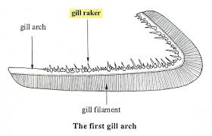
Mouth
-Collection point of food
-Teeth and tentacles for grabbing
Jaws that project forward to engulf the prey
Teeth or special apparatus for grinding (omnivorous &herbivorous)
Gill rakes and mucus to collect phytoplankton
Pumping devices to move water and filter phytoplankton

Slide 7
Mouth
Channel cat fish: large mouth/esophagus, for capturing the prey, mouth has small teeth
Common carp: small mouth for bottom feeding, pharyngeal teeth.
Tilapias : intermediate of bottom feeders, predators, efficient plankton feeders, use gill rakers, pharyngeal mucus

Slide 8
Esophagus
Generally short
Circular and longitudinal muscles to assist in swallowing, mucus to lubricate
Predatory fish the esophagus is distensible to allow the swallowing of large preys

Slide 9
Stomach
True : salmonids, catfish, tilapias, eels
HCL released by parietal cells PH 1.5-3
Pepsinogen released by specialized cells
Activated by HCL, hydrolyses it to pepsin
- no true stomach (carp)
No area of gastric secretion

Slide 10
Intestine
Differentiation depends on species and feeding habits ( clear division and simple tubes)
-digestion of emulsified foods
-absorption of most of the nutrients
- recovery of water and enzymes
- discharge of physiological wastes

Slide 11
Intestine
Channel catfish: length less than whole body
Common carp: digestive system is 3x whole body length.
Tilapia :tract is 6-8 x that of body length
Shrimp: short mid gut with midget gland (used for absorption/ secretion/storage of nutrients, enzymes) intestine length less than body

Slide 12
Requirements for fish
Energy
Proteins
Lipids
Vitamins
minerals

Slide 13
Role of protein
Bulk composition of the body
(structural aspects of the cells)
Oxidative metabolism ( used as energy sources)
Enzymes
Plasma proteins
hormones

Slide 14
Special functions
Peptides (formation of proteins)
Purines/pyrimidins (control ofproteins synthesis)
Histamines
Conjugated proteins (assist in excretion of other compounds)
Pigments ( melanin, drived from amino acids

Slide 15
Proteins and amino acids
Amino acids can be divided into two categories
Non-essential amino acids: synthesized by animal bodies
Essential amino acids: those the fish cannot synthesize in sufficient quantity to support maximum growth

Slide 16
Essential amino acids
Methionine, Arginine,
Threonine, Tryptophan,
Histidine, Isoleucine,
lysine, leucine,
Valine and
Phenyl alanine

Slide 17
Protein and amino acids requirements for fish
Factors affecting proteins and amino acids requirements:
1-fish age is an important factors, amino acids, protein requirements decrease as the fish grow.
2-environmental factors; changes in water temperature affect protein requirements of fish.
Protein requirements are lower for herbivorous fish and omnivorous fish than they are for carnivorous fish, and are higher for fish reared in high density (recirculating aquaculture) than low density (pond aquaculture) systems.

Slide 18
Protein deficiency
Reduced growth
Poor feed conversion
Reduced appetite
Cataracts (methionine)
Scoliosis (tryptophan), lateral curvature of the vertebral column.
caudal fin rot (lysine).

Slide 19
Estimated dietary protein requirement in for maximal growth
Protein% | species
45 | Atlantic salmon
32-36 | Channel cat fish
31-38 | Common carp
30 | Nile tilapia
40 | Rainbow trout
41-43 | Grass carp

